Slide 1
Flat-field correction

Slide 2
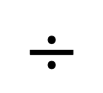
Sample image - BG
Flat field reference
From standard slide
Subtract BG
normalize
Flat field corrected image
Retrospectivly from
recorded images
$$÷$$
Flat field reference
Subtract BG
Average projection
Smooth and normalize
Flat field reference

